Slide 1
Numerical Analysis
Introduction to MATLAB
Lab2

Slide 2
Objectives
To be able to understand the control structure in MATLAB
To be able to create MATLAB m-files
To understands the basics of MATLAB files

Slide 3
Control Structures
General form:
If condition
statements
else
statements
end
If (x>0)
sign=1
elseif (x==0)
sign=0
else
sign=-1
end

Slide 4
Control Structures
General form:
for index=initial: increment: limit
statements
end
while logical expression
statements
end
s=0
for i=1:3:11
s=s+i
end

Slide 5
Examples
for i = 1:2:10
disp(i)
end
for i= 1:10
disp (i)
end
Compare with C Language
for (i=1; i<=n; i=i+2)
{
statements
}

Slide 6
Nested Loop Examples
  for i=1:5 % Fill matrix 1st row and 1st col with 1s
    A(i,1)=1;A(1,i)=1;
  End
  for i=2:5 % Fill remaining matrix
    for j=2:5
      A(i,j)=8 or A(i,j)= A(i,j-1)+A(i-1,j);
    end
  end

Slide 7
Break command in Loop
  for k=1:100 % Use of beak command
    x=sqrt(k);
    if ((k>10)&(x-floor(x)==0))
      break
    end
  End
  n=10;
  k=0;
  while k<=n
    x=k/3;
    disp([x x^2 x^3]) % disp command used to display text or matrix
    k=k+1;
  end

Slide 8
Programming in MATLAB
Files that contain a MATLAB code are called the m-files. There are two kinds of m-files:
  script files
    Script files is a sequence of MATLAB statements and do not take the input arguments or return the output arguments
  function files
    The function files may take input arguments or return output arguments. Function name should be same as the name of the file without .m extension

Slide 9
Programming in MATLAB
script files function files
% script file
A=[1 3 2]
roots(A)
A=A.^2
function [y]=fun(x)
y=x^2+3*x^2+2

Slide 10
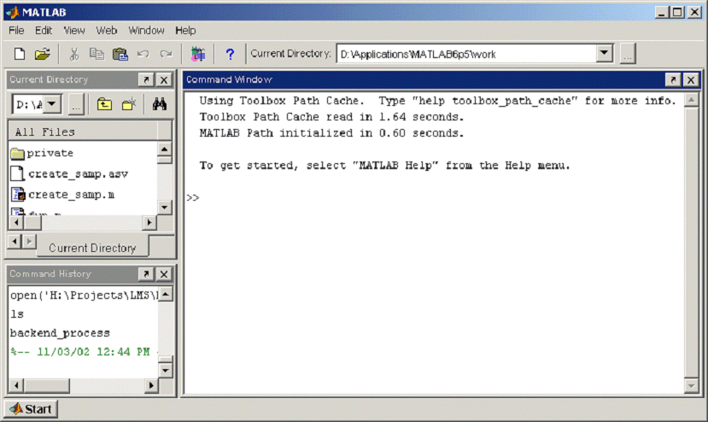
Creating M-files
Select FILE → OPEN → NEW → M-files

Slide 11
MATLAB shortcuts
Create a New
file
Open an existing files

Slide 12
Script verses functions files
Script files
List of MATLAB statements
Variables are global
Run it by typing the file name
Function files
Starts with function
List of MATLAB statements
Variables are local

Slide 13
Programming in MATLAB
Script files
A Script file contains a set of MATLAB command
Use them when you have a long sequence of statements to solve a problem
Can run the program by typing its name in the command window or from tools in the editor window.

Slide 14
Script file to compute Temp
disp('Converting table Cel 2 Fah');
start=input('Start temp in Celsius: ');
incr=input('In-crement in Celsius: ');
total=input('No of Entries in table: ');
stop=start+(total-1)*incr;
C=start:incr:stop;
F=9/5*C+32;
disp('Celsius Fahrenheit');
fprintf('%10.2f %10.2f \n', [C;F]);

Slide 15
Script file to compute factorial
FC=1; % initial value of FC
for i=1:N
FC=FC*i; % n! =(n-1)!*n
end

Slide 16
Script file to compute cos
% program to calculate an estimate of cos(0.2)
% cos(x) ≈1-x^2/2!+x^4/4!
x=0.2
Sum=1
N=2
fact2
Sum=Sum-x^2/FC
N=4
fact2
Sum=Sum+x^4/FC
% Script file fact2
FC=1;
for i=1:N
FC=FC*i;
end

Slide 17
Example
Write a function file to compute the factorial of a number.
Input: N
Output :NF
Function name: factorial

Slide 18
A solution
output
Function name
input
First statement
must start with
‘function’
function [FC]=factorial(N)
FC=1;
for i=1:N
FC=FC*i;
end
Save the program using ‘factorial’ as a name

Slide 19
Creating function file
Open an m-file and start typing the file
function [FC]=factorial(N)
FC=1;
for i=1:N
FC=FC*i;
end

Slide 20
A Better one
function [FC]=factorial(N)
% [FC]=factorial(N)
% program to calculate the factorial of a number
% input N : an integer
% if N is not an integer the program obtains the
% factorial of the integer part of N
% output FC : the factorial of N
%
FC=1; % initial value of FC
for i=1:N
FC=FC*i; % n! =(n-1)!*n
end
These comments will be displayed when
‘help factorial’
is typed

Slide 21
Exercises
Create functions for followings.
Add two number
Subtract two number
Multiply two number
Divide two number and check divisor is not 0.

